Slide 1
MULTIPLE ACCESS TECHNIQUES
The radio channel is a communication medium shared by many users in one geographic region.
Mobile stations compete with one another for the frequency resource to transmit their information streams.
Without any other measures to control simultaneous access of several users, collisions can occur (a multiple access problem)
Since collisions are very undesirable for a connection-oriented communication like mobile telephony, the individual subscribers/mobile stations must be assigned dedicated channels on demand

Slide 2
In wireless communication limited or finite numbers of channels are available for the communication thus multiple access techniques are used to allow many mobile users to share simultaneously a finite amount of radio spectrum.
The sharing spectrum is required to achieve high capacity by simultaneously allocating the available bandwidth to multiple users.
For high quality communication this must be done without severe degradation in the performance of the system.

Slide 3
Three major access techniques used to share the available bandwidth in a wireless communication system.
Frequency Division Multiple Access (FDMA),
Time Division Multiple Access (TDMA) and
Code Division Multiple Access (CDMA)
These techniques can be grouped as narrowband and wideband systems depending upon how the available bandwidth is allocated to the users.

Slide 4
A. Narrowband Systems:
The term narrowband is used to relate the bandwidth of a single channel to the expected coherence bandwidth of the channel
The available radio spectrum is divided into a large number of narrowband channels.
The channels are usually operated using FDD.

Slide 5
In Narrowband FDMA, a user is assigned a particular channel which is not shared by other users in the vicinity, and if FDD is used then the system is called FDMA/FDD.
Narrowband TDMA, allows users to share the same radio channel but allocates a unique time slot to each user in a cyclical fashion on the channel, thus separating a small number of users in time on a single channel.
There are a large number of radio channels allocated using either FDD or TDD, and each channel is shared using TDMA.
Such systems are called TDMA/FDD or TDMA/TDD access systems.

Slide 6
B. Wideband systems:
In wideband systems, the transmission bandwidth of a single channel is much larger than the coherence bandwidth of the channel
Thus multipath fading does not greatly vary the received signal power within a wideband channel and
frequency selective fades occur in only a small fraction of the signal bandwidth at any instance of time.

Slide 7
In this, a large number of transmitters are allowed to transmit on the same channel.
TDMA allocates time slots to the many transmitters on the same channel and allows only one transmitter to access the channel at any instance of time
Two other multiple access techniques will soon be used for wireless communication.
These are…..
Packet Radio (PR) and
Space Division Multiple Access (SDMA).

Slide 8
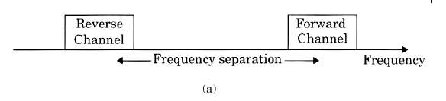
Frequency division duplexing (FDD)
Provides two distinct bands of frequencies for every user.
Forward band----from the base station to the mobile
Reverse band----from the mobile to the base.
Consists of two simplex channels
Duplexer is used
The frequency split between the forward and reverse channel is constant

Slide 9
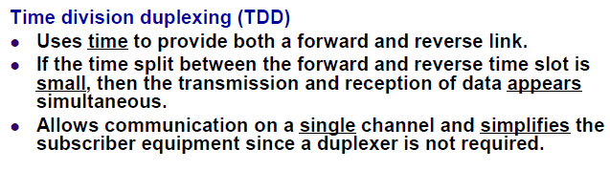



Slide 10


Slide 11
Frequency Division Multiple Access (FDMA)
The entire allocated radio spectrum is divided into many slices of the frequency bands and
each band or channel is allocated to user.
The channel allocation can be done on a demand basis to the users to request service.
When a call is processed, no other user can share the same channel.
Users are assigned a pair of frequencies, one for forward channel and other for reverse channel.
The data to be transmitted is modulated on to each subcarrier, and all of them are linearly mixed together.

Slide 12
Features:
No synchronization necessary
Complexity of system is low
All stations can operate continuously 24 hours without having to wait for their turn to come.
Hard handover is done

Slide 13
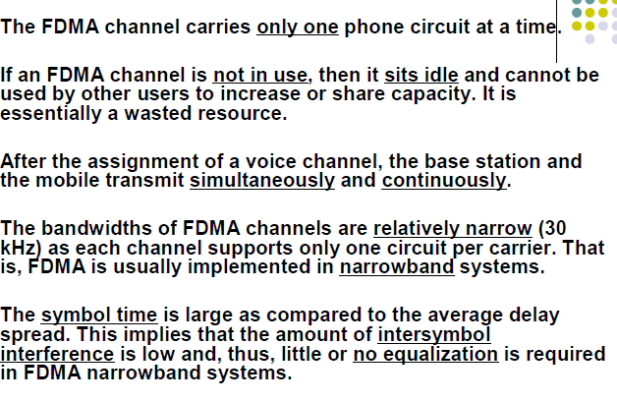

Slide 14
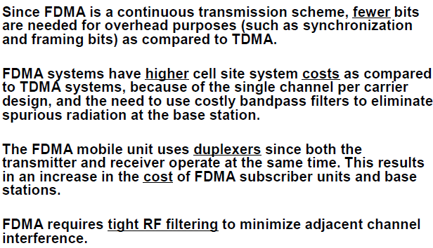

Slide 15
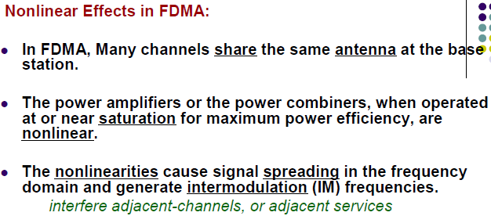

Slide 16
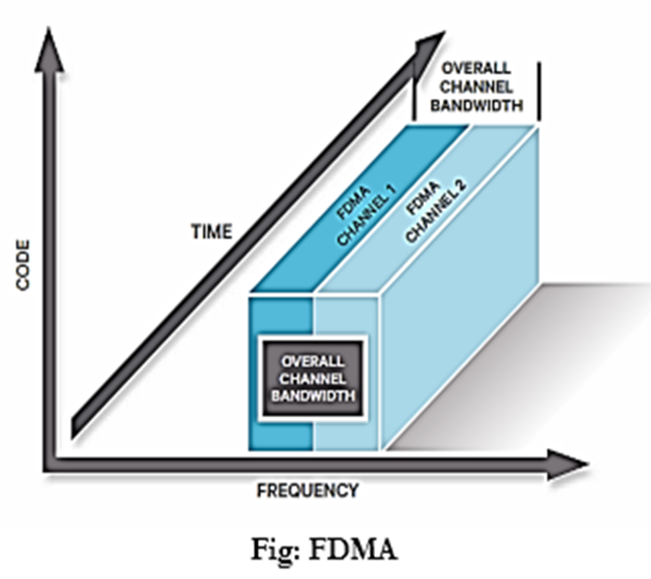
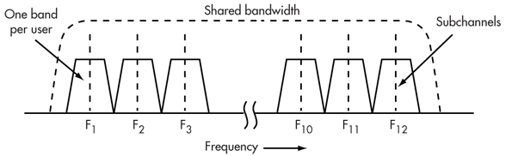

Slide 17
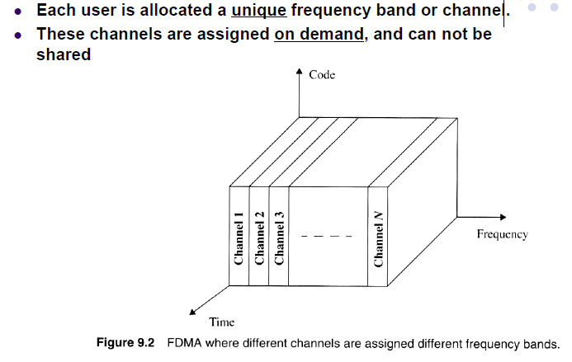

Slide 18
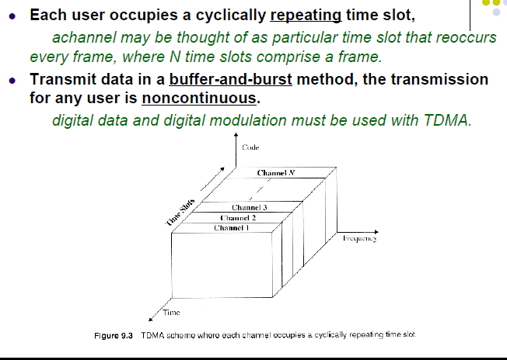
Time Division Multiple Access (TDMA)

Slide 19
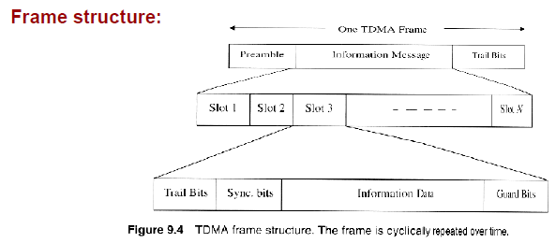
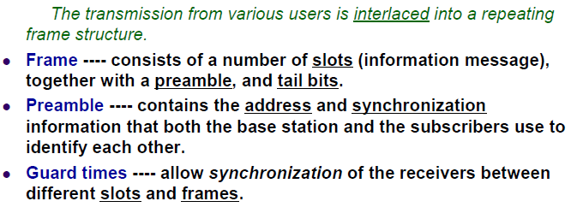

Slide 20
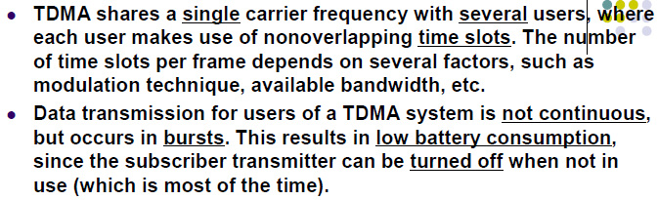

Slide 21
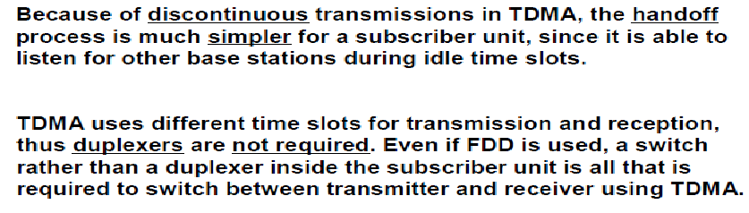

Slide 22
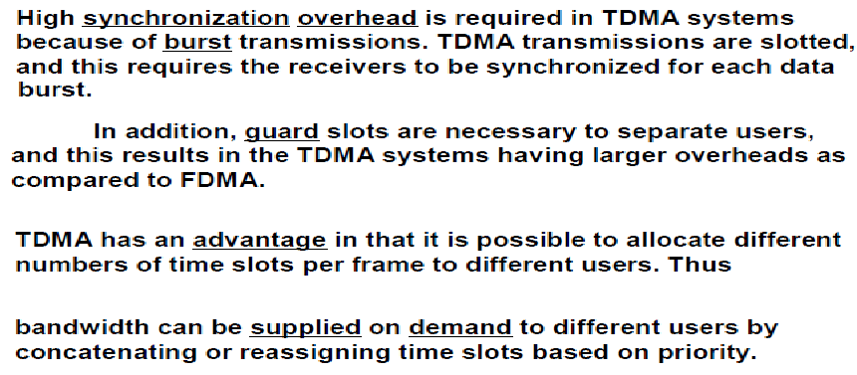

Slide 23
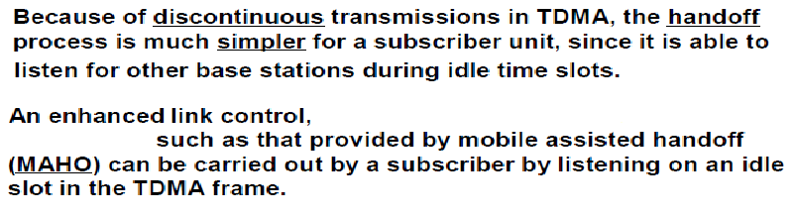
This synchronization, preamble and guard bits are overhead to be sent along with the real information bits and thus reduce the effective channel efficiency.
The efficiency of the a TDMA system (η) is measure of the percentages transmitted data in the frame and id d/as,
Η = (1-b_{oh}/b_{T})*100%
Where b_{oh}= overjead, b_{T}= total no. bits in the frame

Slide 24
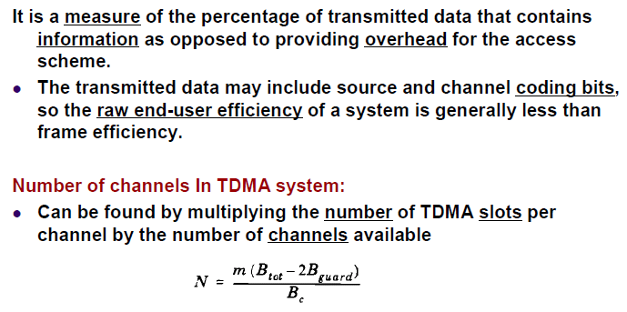

Slide 25
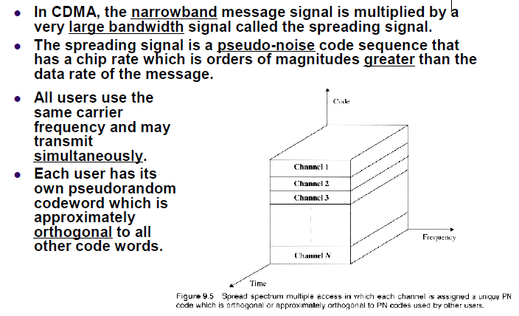
Code Division Multiple Access (CDMA)

Slide 26
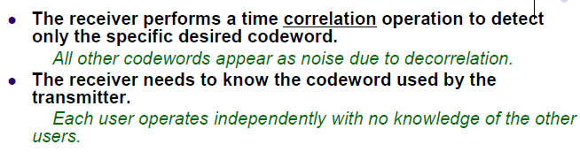
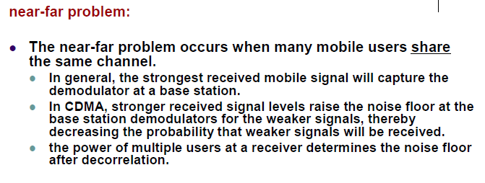

Slide 27
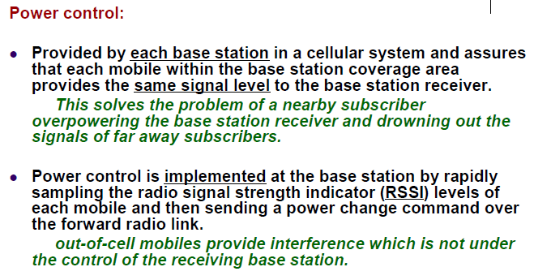

Slide 29
Carrier Sense Multiple Access [CSMA]
(CSMA) is a network protocol that listens to or senses network signals on the carrier/medium before transmitting any data.
CSMAis implemented in Ethernet networks with more than one computer or network device attached to it.
CSMA is part of the Media Access Control (MAC) protocol.

Slide 30
CSMA works on the principle that only one device can transmit signals on the network,
otherwise a collision will occur resulting in the loss of data packets or frames
CSMA works when a device needs to initiate or transfer data over the network.
Before transferring, each CSMA must check or listen to the network for any other transmissions that may be in progress.

Slide 31
If it senses a transmission, the device will wait for it to end.
Once the transmission is completed, the waiting device can transmit its data/signals.
However, if multiple devices access it simultaneously and a collision occurs, they both have to wait for a specific time before re-initiating the transmission process.
CSMA is a network access method used on shared network topologies such as Ethernet to control access to the network.

Slide 32
Devices attached to the network cable listen (carrier sense) before transmitting. ...
Hence it is called I-persistent CSMA.
CSMA is implemented in Ethernet networks with more than one computer or network device attached to it.
CSMA is part of the Media Access Control (MAC) protocol

Slide 33
In other words, a station that wants to communicate "listen" first on the media communication and awaits a "silence" of a preset time (called the Distributed Inter Frame Space or DIFS).
After this compulsory period, the station starts a countdown for a random period considered.
The maximum duration of this countdown is called the collision window (Window Collision, CW).

Slide 34
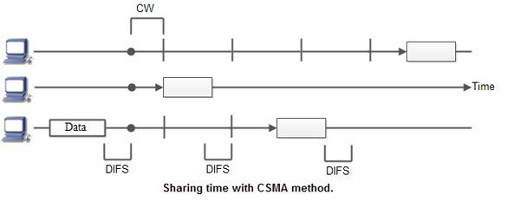
If no equipment speaks before the end of the countdown, the station simply deliver its package.
However, if it is overtaken by another station, it stops immediately its countdown and waits for the next silence.
He or She then continued his account countdown where it left off. This is summarized in Figure

Slide 35
On large networks, the transmission time between one end of the cable and another cable end is enough.
The chances of collision still exist because of propagation delay.
The frame transmitted by one station takes some time to reach other stations.
In the meantime, other stations may sense the channel to be idle and transmit their frames.
This results in the collision.

Slide 36
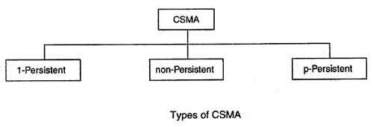

Slide 37
I-persistent CSMA
In this method, station that wants to transmit data continuously senses the channel to check whether the channel is idle or busy.
If the channel is busy, the station waits until it becomes idle.
When the station detects an idle-channel, it immediately transmits the frame with probability 1. Hence it is called 1-Persistent CSMA.
This method has the highest chance of collision because two or more stations may find channel to be idle at the same time and transmit their frames.
When the collision occurs, the stations wait for a random amount of time and start allover again.

Slide 38
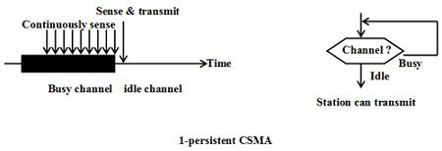
The propagation delay time greatly affects this protocol
If propagation delay time is zero, collision will still occur.
If two stations became, ready in the middle of third station's transmission, both stations will wait until the transmission of first station ends and then both will begin their transmission exactly simultaneously.
This will also result in collision.

Slide 39
(ii) Non-persistent CSMA
• In this scheme, if a station wants to transmit a frame and it finds that the channel is busy (some other station is transmitting) then it will wait for fixed interval of time.
• After this time, it again checks the status of the channel and if the channel is free it will transmit.
• A station that has a frame to send senses the channel.

Slide 40
• If the channel is idle, it sends immediately.
• If the channel is busy, it waits a random amount of time and then senses the channel again.
• In non-persistent CSMA the station does not continuously sense the channel for the purpose of capturing it when it detects the end of previous transmission.

Slide 41
Advantage of non-persistent
It reduces the chance of collision because the stations wait a random amount of time.
It is unlikely that two or more stations will wait for same amount of time and will retransmit at the same time.

Slide 42
Disadvantage of non-persistent
• It reduces the efficiency of network because the channel remains idle when there may be stations with frames to send.
This is due to the fact that the stations wait a random amount of time after the collision.

Slide 43
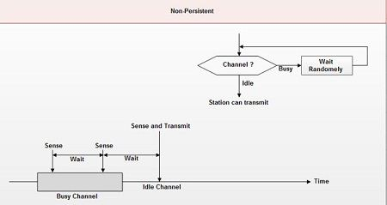

Slide 44
p-persistent CSMA
This method is used when channel has time slots such that the time slot duration is equal to or greater than the maximum propagation delay time.
• Whenever a station becomes ready to send, it senses the channel.
• If channel is busy, station waits until next slot.
• If channel is idle, it transmits with a probability p.
• With the probability q=1-p, the station then waits for the beginning of the next time slot.
• If the next slot is also idle, it either transmits or waits again with probabilities p and q.
• This process is repeated till either frame has been transmitted or another station has begun transmitting.
• In case of the transmission by another station, the station acts as all the same, a collision has occurred and it waits a random amount of time and starts again.

Slide 45
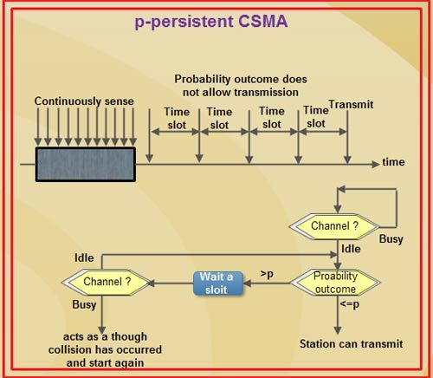

Slide 46
Advantage of p-persistent
• It reduces the chance of collision and improves the efficiency of the network.

Slide 47
“ How to select that Probability“?.
Assume that N nodes have a packet to send and the medium is busy
Then, Np is the expected number of nodes that will attempt to transmit once the medium becomes idle.
If Np > 1, then a collision is expected to occur. Therefore, the network must make sure that Np <= 1 to avoid the collision, where N is the maximum number of nodes that can be active at a time.

Slide 48
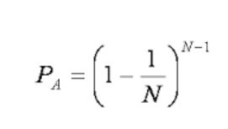
The logic used to check whether a station is able to transmit or not
firstly the value of variable P is calculated and based on that value the decision is made
If P <= 1, station can transmit
Else (i.e. P > 1), it has to wait
Now it comes the part of "how to calculate the variable P", using a very simple equation below, where N is the number of stations that are connected to the shared medium.

